Slide 1


ECOSYSTEM
Gurween Kaur
Department of CSE/IT

Slide 2
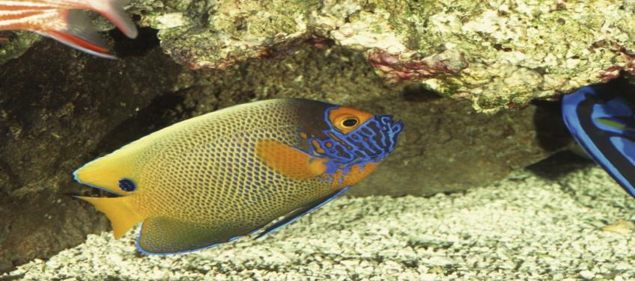
ECOSYSTEMS

Slide 3
DEFINATION
An ecosystem is a natural unit consisting of all plants, animals, and micro-organisms in an area functioning together with all the non-living physical factors of the environment.
A group of organisms interacting among themselves and with environment is known as ecosystem. Thus an ecosystem is a community of different species interacting with one another and with their non living environment and one another and with their non- living environment exchanging energy and matter.

Slide 4
What is an ecosystem?
An ecosystem is a natural unit consisting of all plants, animals, and micro-organisms in an area functioning together with all the non-living physical factors of the environment.
A group of organisms interacting among themselves and with environment is known as ecosystem. Thus an ecosystem is a community of different species interacting with one another and with their non living environment and one another and with their non- living environment exchanging energy and matter.

Slide 5
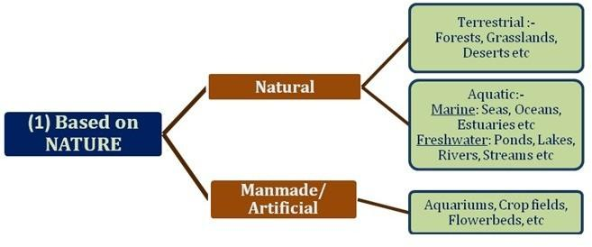
Classification of ecosystem

Slide 6
Kinds of Ecosystems
Natural Ecosystems
Man-made Ecosystems
Terrestrial Ecosystems
Aquatic Ecosystems
Fresh water Ecosystems
Marine Ecosystems
Lentic Ecosystems (Static water)
Lotic Ecosystems (Running water)

Slide 7
Structure of an Ecosystem
Living (Biotic) Components
Producers
Consumers
Decomposers
Non-living (Abiotic) Components
Physical factors
Chemical factors
Limiting factors

Slide 8
Biotic Components of Ecosystems
Producers (or autotrophs)
Green plants and some bacteria which manufacture their own food.
Consumers (or heterotrophs)
Animals which obtain their food from producers
Primary consumers
Secondary consumers
Tertiary consumers
Decomposers
Bacteria and fungi that decompose dead organic matter and convert it into simpler parts

Slide 9
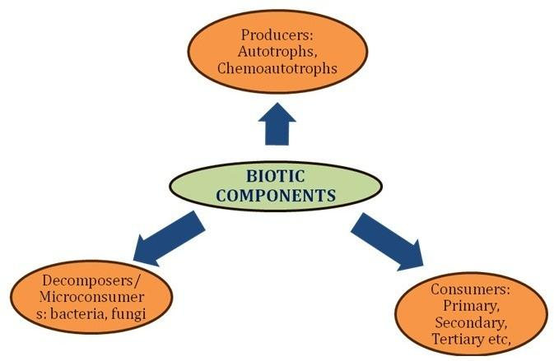

Slide 10
THANK YOU

